Slide 1


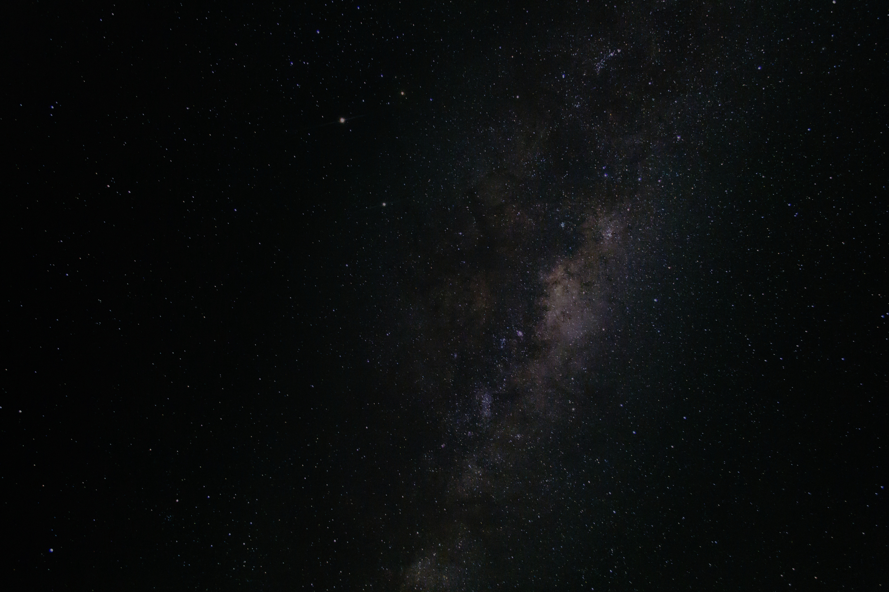
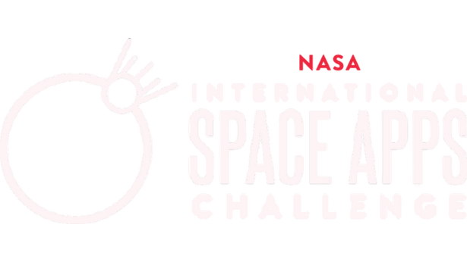

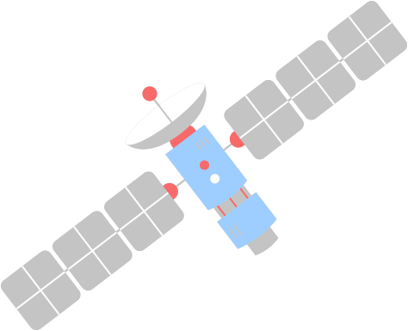

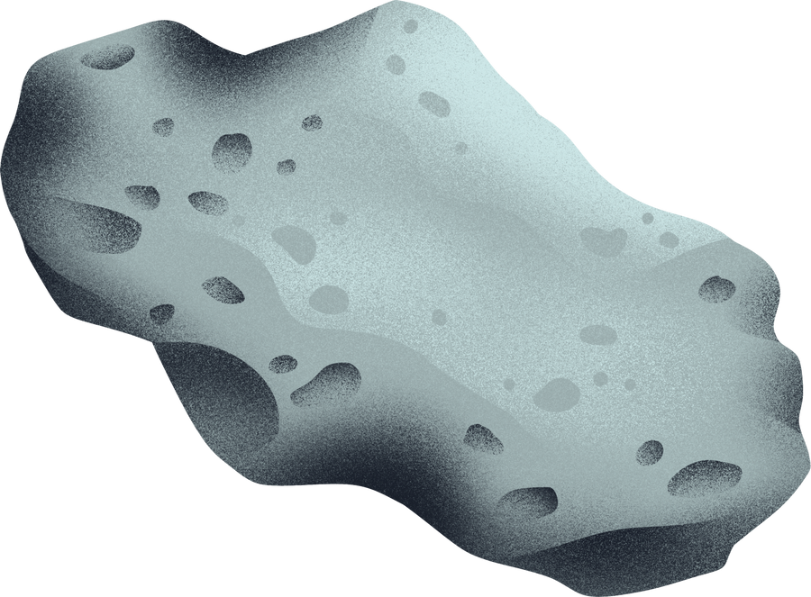

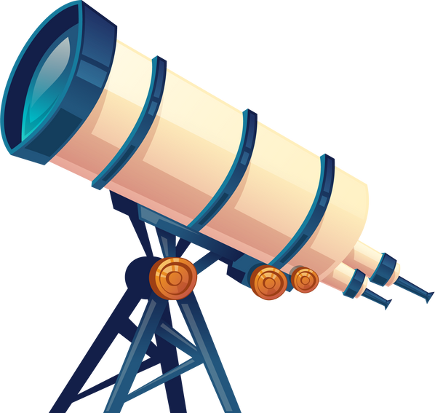
METEOR SIMULATION
Presented by
Ahmed Osama.
Mahmoud Marie.

Slide 2

Executive Summary
Near-Earth asteroids like the hypothetical “Impactor-2025” highlight the risk of celestial objects colliding with Earth. Such impacts can trigger tsunamis, seismic events, and atmospheric disturbances. NASA’s NEO API provides real-time asteroid parameters while the USGS offers topography, tsunami, and seismic datasets. Our web-based Asteroid Impact Simulator fuses NASA orbital data with USGS environmental layers to create an interactive decision-support and learning platform. Users select or customize asteroid parameters, run physics-based simulations, and visualize 3D orbital paths, impact zones, and secondary effects. Mitigation strategies like kinetic impactors can also be tested while infographics and a gamified “Defend Earth” mode keep the science engaging and accessible.

Slide 3

Background & Literature Review
NASA’s Planetary Defense Coordination Office and JPL’s databases provide orbital and physical parameters for thousands of NEOs. Tools like JPL Horizons and Impact Earth demonstrate accurate physics but remain technical or narrow in scope. Educational platforms simplify impact effects but omit critical environmental datasets, limiting scientific rigor. Integrating NASA NEO API with USGS topographic, seismic, and tsunami data using validated impact-physics models offers a novel comprehensive solution.

Slide 4
Problems Definition
The Integration Gap
Reaching Wider Communities
Enhancing Participation
Current tools fail to integrate asteroid orbital data with its potential Earth-impact consequences. Platforms are fragmented, typically focusing either on technical tracking data or on oversimplified visualizations, but not connecting the two in a scientifically accurate way.
There is a major disconnect between complex scientific data and public understanding. Existing systems present information that is either too technical for non-specialists (policymakers, the public) to comprehend or too "dumbed-down," lacking scientific rigor.
This failure to integrate and translate data means stakeholders cannot effectively perform crucial tasks. They are unable to properly evaluate threat levels, compare different mitigation strategies, or understand the true scale of potential asteroid hazards within their specific regional context.

Slide 5
Tactical Planning
The simulator directly addresses this by integrating NASA's asteroid data with USGS environmental layers. By doing this, it connects the abstract astronomical data (the asteroid's path) with its realistic, terrestrial consequences in a single, unified platform.
Seamiess Implementation
The simulator uses interactive 3D visualizations and intuitive controls to translate complex data into an accessible and understandable experience. This allows non-specialists to explore scenarios easily while maintaining scientific accuracy, bridging the gap between overly technical data and inaccurate, oversimplified graphics.
SOLUTIONS
Thorough Evaluation
The simulator empowers users to take virtual action by allowing them to adjust variables (like asteroid size and velocity) and test different defensive strategies. Most importantly, they see instant updates to the predicted impact zones, which supports serious risk analysis and actual planning for planetary defense.

Slide 6
Methodology
Data Integration:-
Fetch live asteroid data from NASA NEO API and JPL SBDB; ingest USGS DEMs, tsunami zones, and seismic hazard maps.
Simulation Engine:-
Use orbital-mechanics libraries to propagate trajectories and calculate impact probabilities.
Impact Physics:-
Implement formulas to estimate crater size, blast radius, seismic magnitude, and tsunami generation.,
Visualization:-
Build a React/Cesium web app for 3D orbital paths and Earth overlays.
Mitigation Module:-
Model kinetic impactors and gravity tractors by applying delta-v changes.
User Experience:-
Provide tooltips, infographics, and a gamified “Defend Earth” scenario.
Workflow:-
Analyze requirements, build a minimal viable product with live NASA data and a basic orbit visualizer, integrate impact calculations and USGS overlays, add mitigation features, test, and refine.

Slide 7
Value Proposition:-
Our platform uniquely combines scientific rigor with an intuitive interface. It educates the public, supports policymakers, and encourages early detection advocacy. By merging trusted datasets and validated physics, it surpasses existing tools that are either too technical or oversimplified
Roles Of Team Members:-
Mahmoud Marie:-
Ahmed Osama:-
Development tools
References
Demo
Summary
Resources:-
NASA NEO API & JPL Small-Body Database
USGS DEM, tsunami, and seismic datasets
Poliastro, Python/NumPy/SciPy
React, CesiumJS for 3D visualization
Reference: Collins et al., Earth Impact Effects Program (2010)

